Slide 1

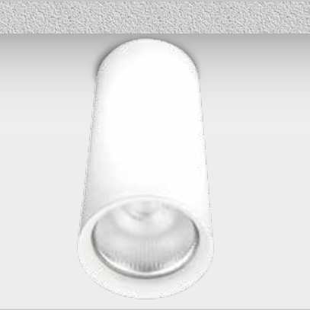






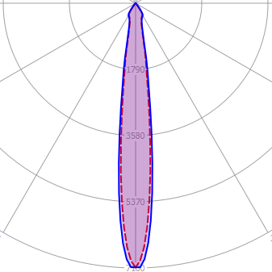
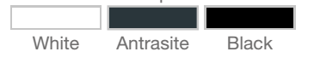


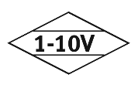
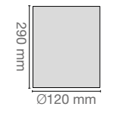


SURFACE MOUNTED SPOTLIGHT
OUD-11.40.90N
Order Code : L0050043.40.90N
Product Code : OUD-11.40.90.N
Features
Color : RAL
Body : Alumium
IP Grade : IP44
Installation : Recessed Mounted
Lighting Source : Mid Power LED
Performance Data
Power : 45 W
Flux : 3684 lm
Efficiency : 81 lm/W
Voltage : 220-240 V AC
Frequency : 50-60 Hz
Power Factor : > 0,9
CCT (K) : 4000 K
CRI : > 90
Photometric Curve
Color Options
Dimensions
www.siberled.com
İstanbul Yolu 26. Km Susuz mah. Yenimahalle / Ankara / Türkiye
T: +903123517686 siber@siberled.com

