Slide 1

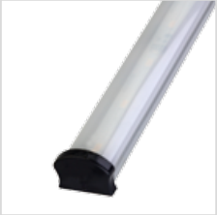

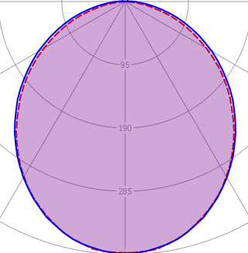





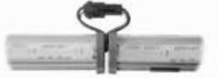
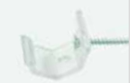


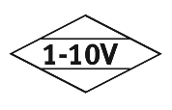
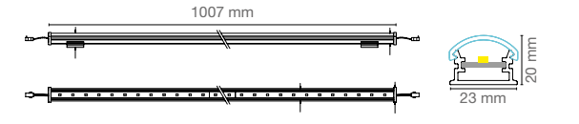


COVE
COVE.1500.OP.27
Order Code : L0050077.OP.27
Product Code : COVE.1500.OP27
Features
Body : Alumium
IP Grade : IP44
Installation : Recessed Mounted
Lighting Source : Mid Power LED
Performance Data
Power : 14 W
Flux : 1130lm
Efficiency : 62 lm/W
Voltage : 220-240 V AC
Frequency : 50-60 Hz
Power Factor : > 0,9
CCT (K) : 2700 K
CRI : > 80
Photometric Curve
Lıght Continuty
Mounting Kits
Dimensions
www.siberled.com
İstanbul Yolu 26. Km Susuz mah. Yenimahalle / Ankara / Türkiye
T: +903123517686 siber@siberled.com

