Slide 1


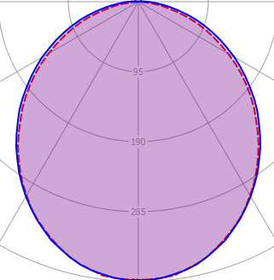
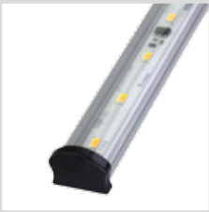





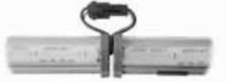
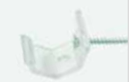


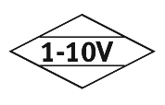
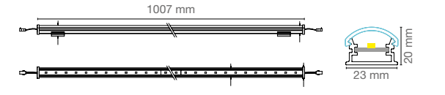


COVE
COVE.200.CL.40
Order Code : L0050074.CL.40
Product Code : COVE.200.CL.40
Features
Body : Alumium
IP Grade : IP44
Installation : Recessed Mounted
Lighting Source : Mid Power LED
Performance Data
Power : 4 W
Flux : 336lm
Efficiency : 85 lm/W
Voltage : 220-240 V AC
Frequency : 50-60 Hz
Power Factor : > 0,9
CCT (K) : 4000 K
CRI : > 80
Lıght Continuty
Mounting Kits
Dimensions
www.siberled.com
İstanbul Yolu 26. Km Susuz mah. Yenimahalle / Ankara / Türkiye
T: +903123517686 siber@siberled.com

